Slide 1
Parallel Poisson 2D Solver
Dewi Yokelson and Cameron Durbin
December 8, 2020

Slide 2
Project Summary
Solve a 2D Poisson problem
Parallelize with CUDA
Experiments
Results

Slide 3
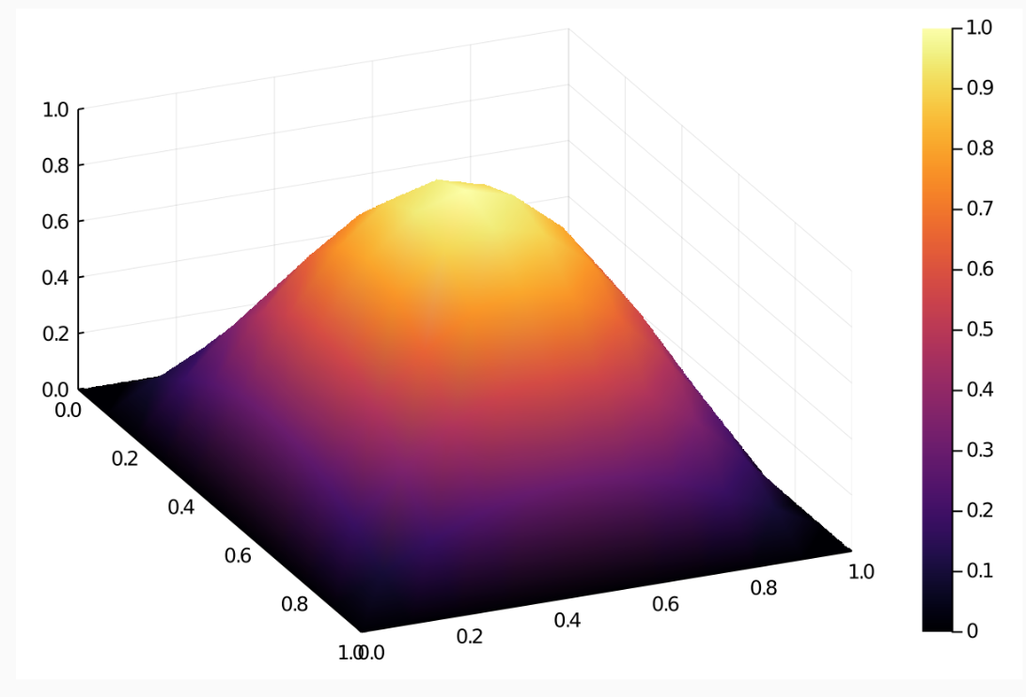
Poisson Problem setup
Steady State Heat Equation
Uniform Square Plate
Boundaries all held at 0
The “source term” F(x,y) represents heat being applied
K[U_{xx} + U_{yy}] + F(x,y) = 0
F(x,y) = 2kπ²(sin(πx)sin(πy))
Exact Solution U_{e} = sin(πx)sin(πy)

Slide 4
Conjugate Gradient Approach
Discretize in space
Form Ax + b
Data setup in Julia – code in C++/CUDA/CUBLAS
https://people.eecs.berkeley.edu/~demmel/cs267/lecture24/lecture24.html

Slide 5
CUDA Implementation
Conjugate Gradient method calls parallelized matrix/vector functions
CUBLAS Library for most kernels (dot product, gemv)
Custom vector add kernel

Slide 6
experiments
Convergence tests
Increase matrix dimensions
Experiment with thread/block count

Slide 7
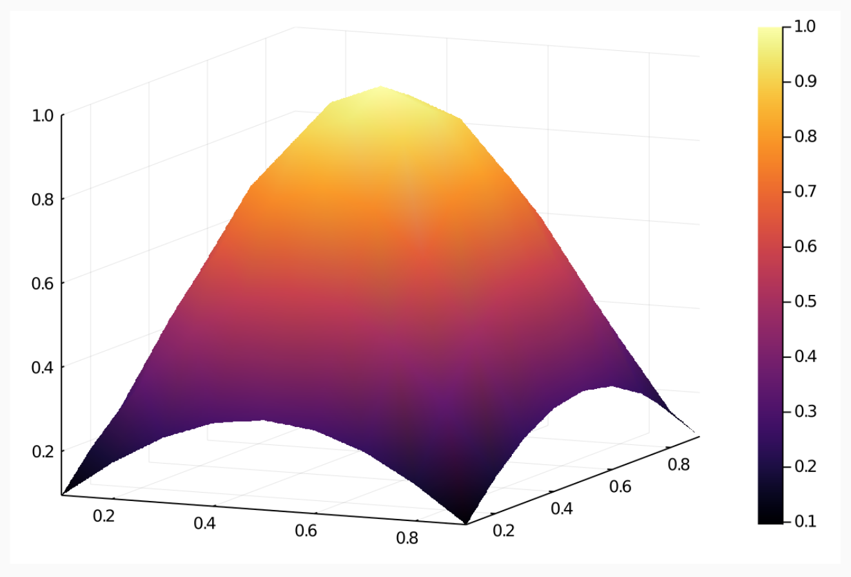
RESULTS
Exact
Approximate

Slide 8
Results

Slide 9
Results

Slide 10
Results

Slide 11
Future Work
Continue experimenting with different thread/block sizes
Create larger input data set
Compare with serial implementation
Compare with sparse matrix implementations

Slide 12
Questions?

